Slide 1
2023 Communications Presence Review

Slide 2
Table of Contents
Social Media
Analytics
Top Performing Posts
Earned Media
News Media Stories
Press Conferences
Paid Media
Branding, Immunizations, and STI/HIV Videos
Septa Syphilis and HPV Vaccination Campaigns
Video Production
DCHD Full House
Drive-Thru Flu Shot Clinic

Slide 3



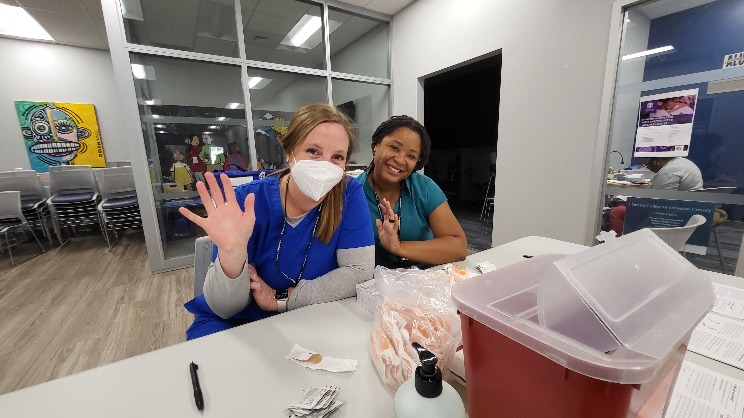

Social Media The Delaware County Health Department Maintains 3 individual Social Media Accounts -DCHD has access to the County YouTube and LinkedIn Channels
Facebook - @DelcoHealth
Dec. 2023 -1.4k Followers 98.6K Reached - 2023
Dec. 2022 -600 Followers 7.6K Engagements - 2023
Instagram - @delcohealthdepartment
Dec. 2023 560 Followers 19.6K Impressions - 2023
Dec. 2022 292 Followers Average 3k per month
X(Twitter) - @DelcoHD
Dec. 2023 147 Followers 24.8K Impressions - 2023
Dec. 2022 50 Followers Average 2k per Month

Slide 4


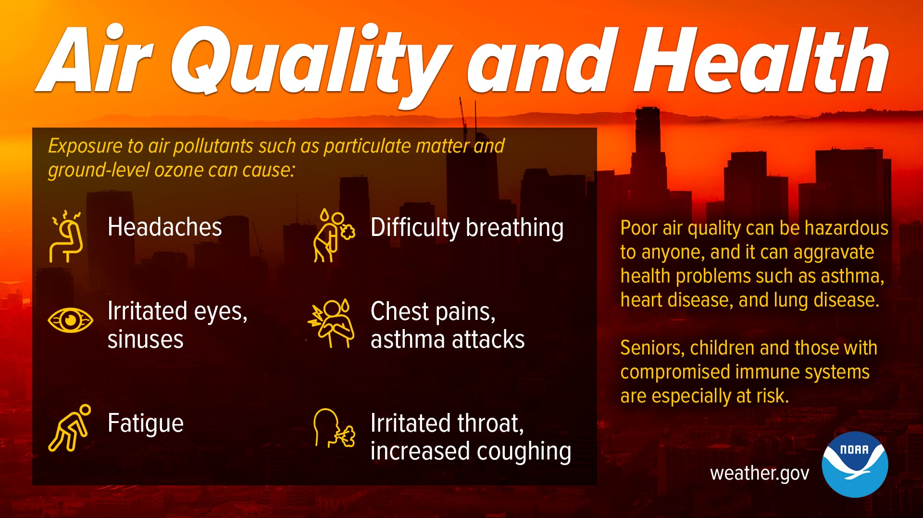
Top Performing Social Media Posts
Black History Month Public Health Pioneer
DCHD Full House Reel
Canadian Wildfire
Facebook
5,419 Accounts Reached
994 Engagements
Facebook
15.9K Accounts Reached
2.4K Engagements
651 views
80 interactions
Instagram

Slide 5
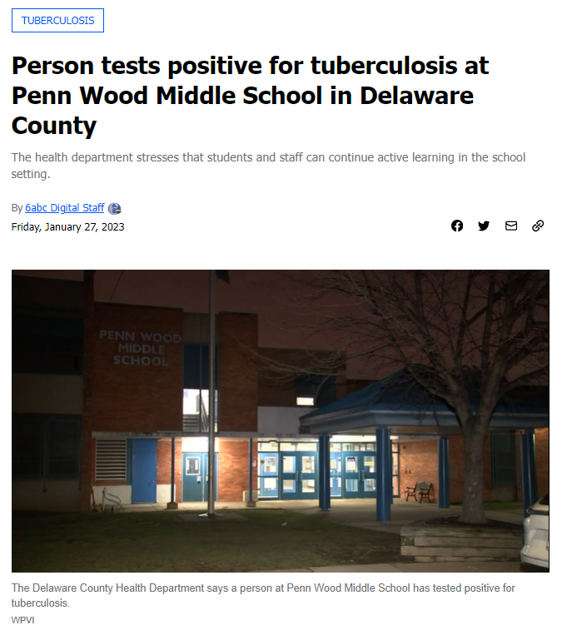


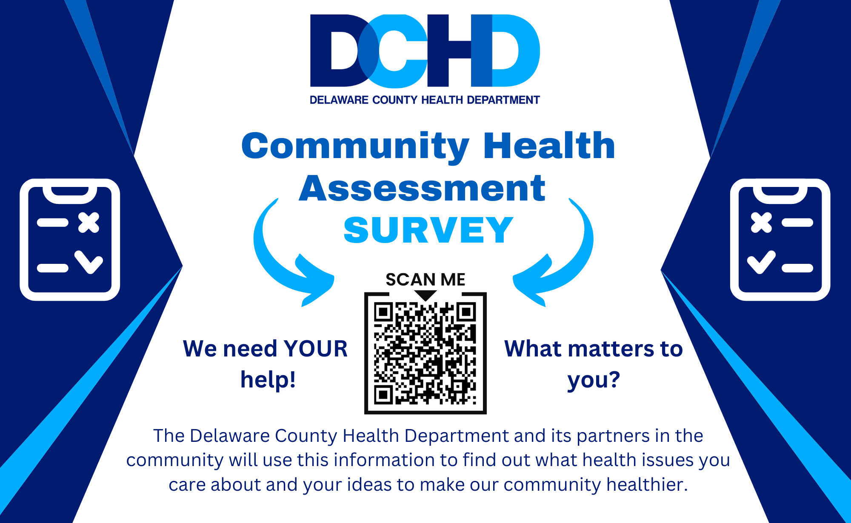
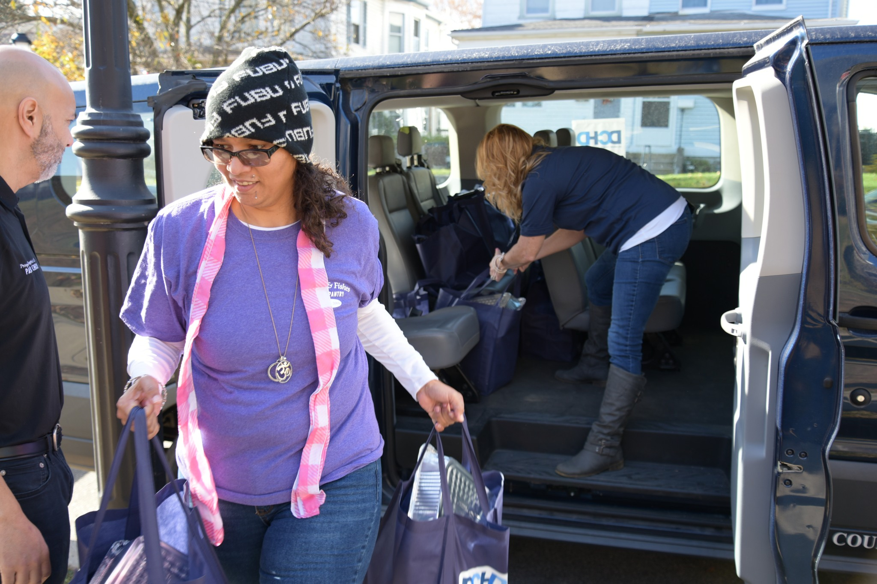
Earned Media -Earned Media is referred to as no cost local or national news coverage.
Top Stories
Penn Wood Tuberculosis Case
DCHD Delivers 1-Year Department Anniversary Gift
Community Health Assessment Launch
Jefferson Mammogram Screening Events
DCHD Delivers Thanksgiving
Deterra Drug Deactivation System Pouch Mailing Campaign

Slide 6
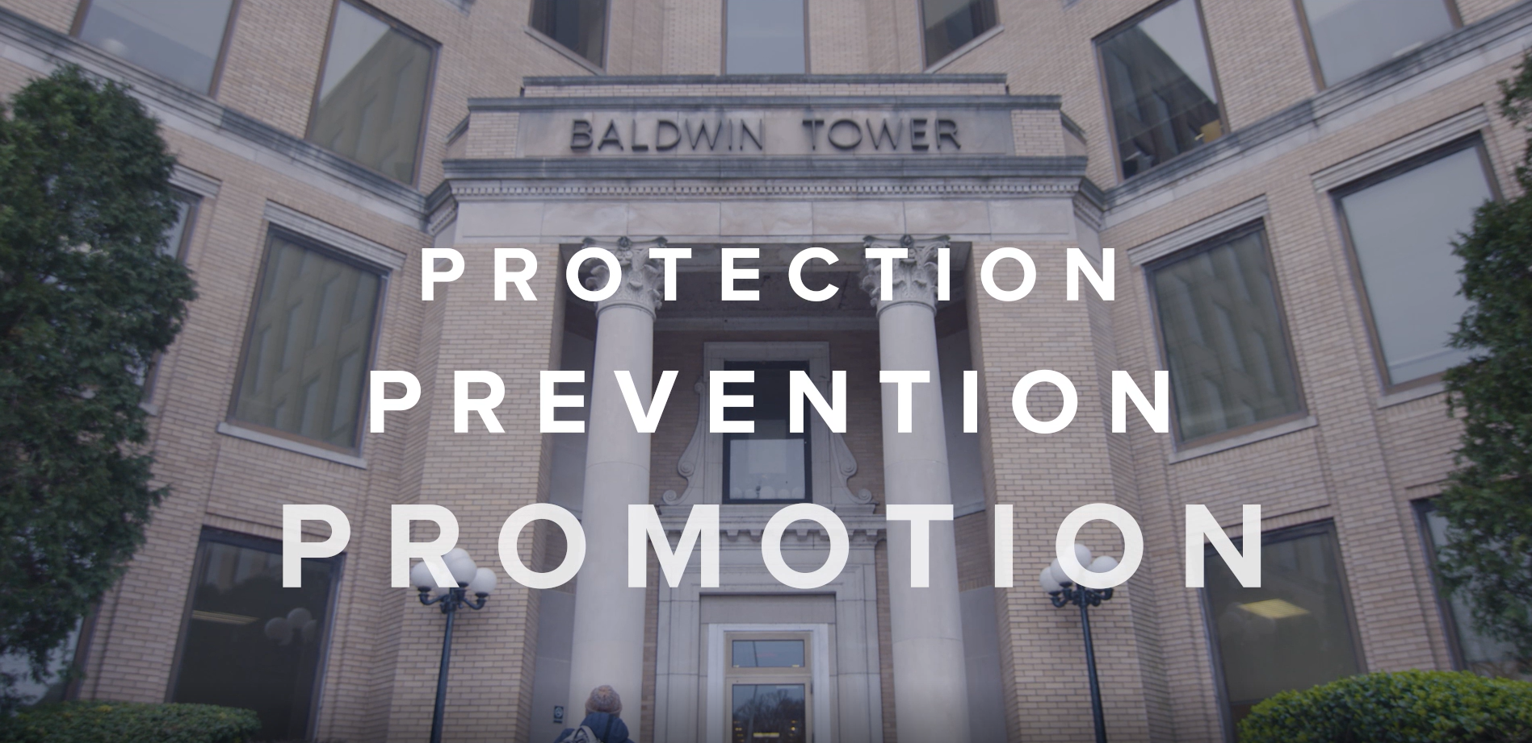
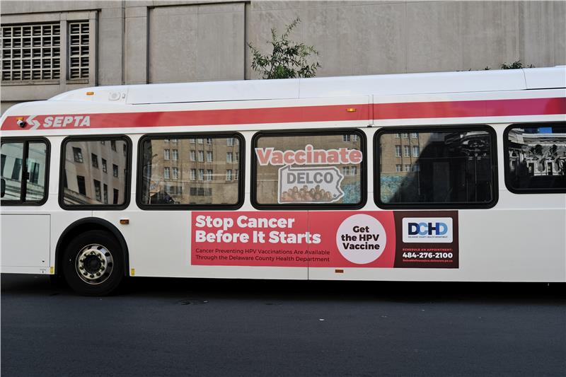

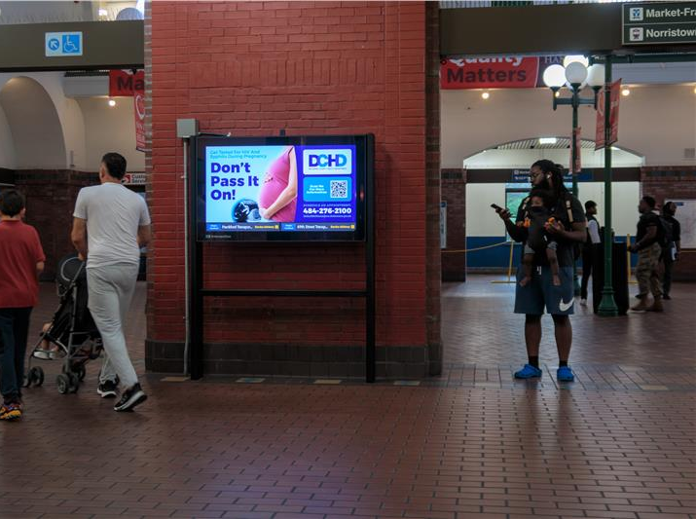
Paid Media
Paid Media
Elemeno Productions:
Branding, STI/HIV, and Immunizations Videos
Septa:
Syphilis Awareness and HPV Vaccination Campaigns

Slide 7
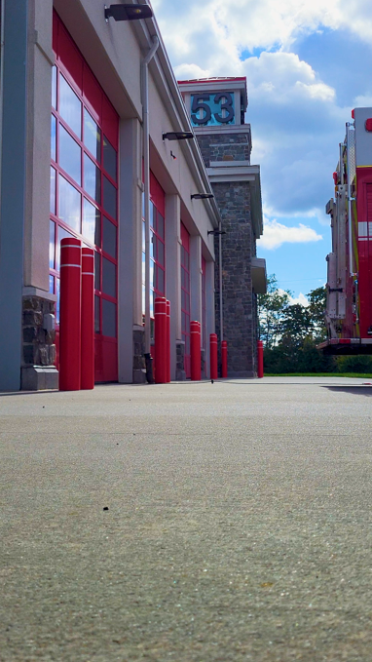
Drive-Thru Flu Shot Clinic
https://www.youtube.com/shorts/Z7ffW2yli1s

Slide 8
DCHD Full House
https://www.youtube.com/shorts/lXIy2y9In3E

